Slide 1


Fundamentals of RM
RM System and Process
Leadership in RM
Incident Investigation
RM Tools & Challenges
RM in Industry
People & Org.
Application and Perspectives
On Becoming a
Leader in Risk Management
ENGG404 - Lecture
Case 12: Lessons from the
ALCOA Success Story

Slide 2
Learning Outcomes:
Explain the success story of Paul O’Neill, CEO, and the Aluminum Company of America (Alcoa)
Demonstrate what practicable programs can support the implementation of cultural change.
Critique the culture and performance of any organization using the principles and practices of leadership in risk management, using this case study as a model for analysis.
Case 12: Lessons from the ALCOA Success Story
2
Notes:
2

Slide 3
Key Points in this Success Story:
Go beyond “What gets measured, gets managed”.
Paul O’Neill, CEO, Aluminum Company of America (Alcoa)
Change Starts At The Top.
The Reaction of the Financial Analysts on Wall Street.
Five practicable programs to support and implement the desired change in corporate cultures.
The Legacy:
Safety Performance
Financial Performance
The Key Lessons
Case 12: Lessons from the ALCOA Success Story
3
Notes:
3

Slide 4

Go Beyond “What gets measured, gets managed”:
Widely observed in industry: “What gets measured, gets managed”.
Recall BP-Macondo DeepWater Horizon and the intensive measurements of occupational safety performance and apparent lack of measurements of process safety performance.
Karl Pearson’s Law:
“When performance is measured,
performance improves.
When performance is measured and
reported back, the rate of improvement
accelerates.”
Case 12: Lessons from the ALCOA Success Story
4
Notes:
4

Slide 5
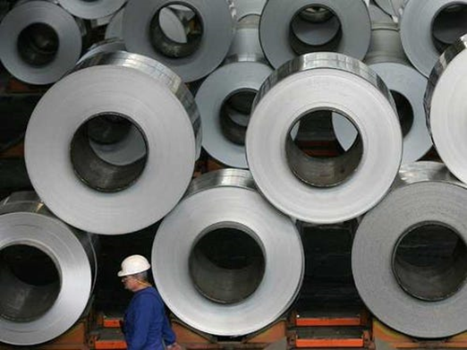
Go Beyond “What gets measured, gets managed”:
Paul O’Neill, Alcoa CEO, leveraged this law (measure and report back) in changing culture at Alcoa and improving safety performance.
Case 12: Lessons from the ALCOA Success Story
5
Notes:
5

Slide 6
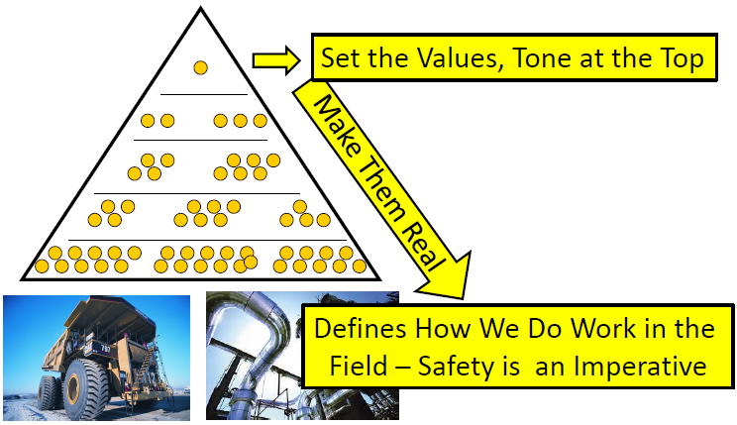
Change Starts At The Top:
Recall that to improve performance, culture must change, and that to change culture, the change starts at the very top of the organization.
So, the change in values, the “Tone at the Top”, initiates the change in corporate culture.
This triangle depicts:
President / CEO at the top;
Vice Presidents at the next level,
Senior Managers,
Middle Managers, Supervisors;
Workers
The message AND actions MUST be consistent throughout!
Lower levels MUST NOT undermine!
Case 12: Lessons from the ALCOA Success Story
6
Notes:
6

Slide 7
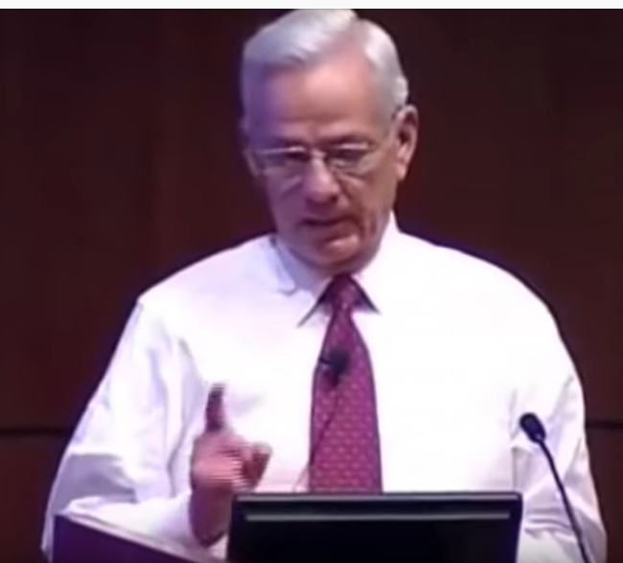
Change Starts At The Top:
Paul O'Neill CEO of Alcoa - It's all about safety; Charter Partners; posted 12-Jun-2015; 12m58s; accessed 31-Oct-2019 https://www.youtube.com/watch?v=tC2ucDs_XJY
Case12 ALCOA vid1 ONeill Its all about safety Charter Partners 12m58s.mp4
    07:50-08:35 “Here is what I mean by this
    (zero injuries is our goal) …
    I don’t want to budget it, I want to fix it.”
    09:32-10:59 “We killed him. I killed him.”
    Management accountability at its best
    under the most unfavorable, difficult, and
    unpleasant of conditions.
When leadership sets the “tone at the top” AND upholds the values and commitment that “nobody gets hurt around here”, it follows that this initiates the change in culture.
Case 12: Lessons from the ALCOA Success Story
7
Notes:
7

Slide 8

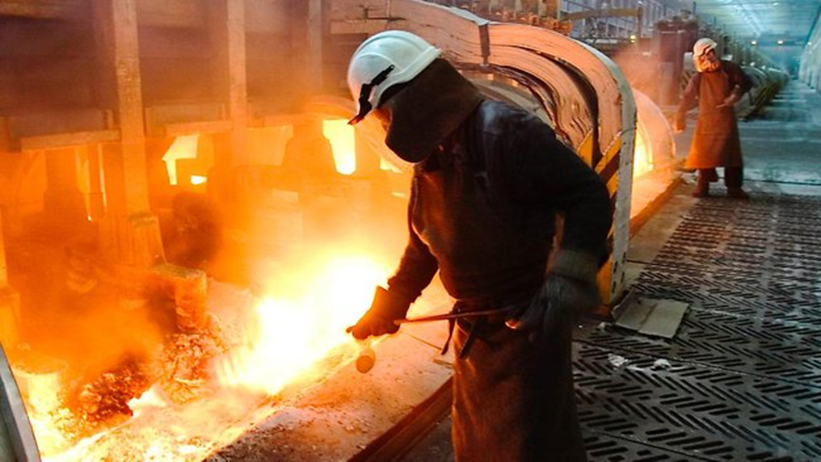
Change Starts At The Top:
Excerpts from article: The Power of Safety Leadership: Paul O’Neill, Safety and Alcoa; Posted by Aerossurance 29-Dec-2014; accessed 31-Oct-2019; http://aerossurance.com/helicopters/paul-oneill-safety-alcoa-power-safety-leadership/
October 1987, Paul O'Neill gave his first speech as CEO of Alcoa to
a crowd of financial analysts: “I want to talk to you about worker safety.”
The room went silent.
“Every year, numerous Alcoa workers are injured so badly that they miss a day of work. I intend to make Alcoa the safest company in America. I intend to go for zero injuries.”
When asked about inventories and profits,
he responded, “If you want to understand
how Alcoa is doing, you need to look
at our workplace safety figures.”
This was radical in 1987!
Case 12: Lessons from the ALCOA Success Story
8
Notes:
8

Slide 9
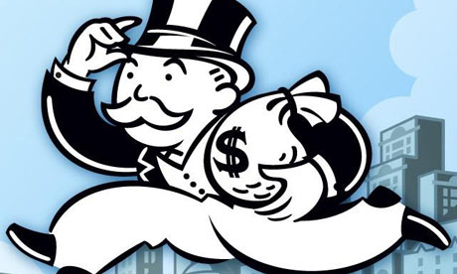
The Financial Analysts’ Reactions:
The financial analysts perceived this as “Profits don’t matter as much (to this CEO) as safety.”
Investors in the room almost stampeded out the doors when the presentation ended. One jogged to the lobby, found a pay phone, and called his 20 largest clients. “The board put a crazy hippie in charge and he’s going to kill the company. I ordered them to sell their stock immediately, before everyone else in the room started calling their clients and telling them the same thing.”
However, that investor admitted that in
the long run he recognised that:
“It was literally the worst piece of advice
I gave in my entire career.”
Case 12: Lessons from the ALCOA Success Story
9
Notes:
9

Slide 10
Five Practicable Programs:
In a presentation to The Carnegie Council in 2012, former Alcoa VP Bill O'Rourke indicated five programs that O’Neill had implemented to influence:
1) Safety was at the Top of the Meeting Agenda:
Plant managers, senior management, Board of Directors, Shareholders, Financial Analysts
2) Report Incidents Within 24 Hours:
  Who was hurt?
  Why they were hurt?
  What have you done about it?
3) Real-time Safety Performance Data:
4) Safety Audit Program and Department (Resources and Authority):
  5) Plant Manager Training:
  The training was condensed in two lessons for Plant Managers:
    “Don’t fail an audit.”
    “Don’t mess with safety programs and requirements.”
  Key Lesson:
  In other words, do everything possible to effectively implement the safety program at your plant (your area of responsibility)! (ESG KP#2 Understand your program!)
Case 12: Lessons from the ALCOA Success Story
10
Notes:
10

Slide 11
Example: Alcoa Five Programs and RM Elements
Program alignment to APEGA RM Elements:
Safety at the Top of all Meeting Agendas:
1) MLCA
Report Incidents Within 24 Hours:
1) MLCA, 5) IRIA&A
Real-time Safety Performance Data:
5) IRIA&A, 8) O&M
Global Safety Audit Program and Department:
6) PECI
Plant Manager Training:
1) MLCA, 9) EC&T
(See additional comments in the Notes section)
APEGA RME:
MLCA
RA&MR
CAER
MOC
IRIA&A
PECI
DC&SU.
O&M
EC&T.
CC&I
OFID
Case 12: Lessons from the ALCOA Success Story
11
Notes:
11
Safety at the Top of all Meeting Agendas:
1) MLCA – It was O’Neill’s commitment to make “safety the most important thing / top priority” (a value, as we would term it now) at Alcoa, and his steadfast commitment to that value set the tone at the top and for all those who reported directly to him and on down through line management. He communicated his commitment to shareholders and directors, and was unwavering in his commitment. Safety performance was the first topic on the agenda at annual shareholders’ meetings, Board of Directors meetings, quarterly reviews with senior management, and all other periodic management meetings.
Report Incidents Within 24 Hours:
1) MLCA – It was O’Neill’s unwavering requirement that plant managers must report directly to him within 24 hours about a loss incident.
5) IRIA&A – This element describes the requirements for what the plant manager / business manager must report, in what time frame, and the minimum information: “Who was hurt, why they were hurt, and what have you done about it?”
Real-time Safety Performance Data:
1) MLCA - Plant managers are accountable for safety performance, not the safety manager / safety professional. The lecturer may need to describe the shift in culture from “it’s the safety manager’s responsibility” to “it is the manager’s responsibility”.
8) O&M – Policies and procedures (administrative controls) need to be in place in order to track, record, and report data on a daily basis across the global organization in order to provide meaningful and accurate data to the executive offices and all line management.
Safety Audit Program and Department (Resources and Authority):
1) MLCA and 6) PECI - Safety Audit Program and Department: people and resources with same level of authority and discipline as a financial audit department; plant managers reported audit failures directly to the Board of Directors.
Plant Manager Training:
1) MLCA, 9) EC&T - The training boiled down to two lessons for Plant Managers: 1) Don’t fail an audit. 2) Don’t mess with safety. If you fail an audit, you must report directly to the Board of Directors as to what you will do to fix it. If you fail a second audit, your successor must report directly to the Board of Directors as to what they will do to fix it.

Slide 12
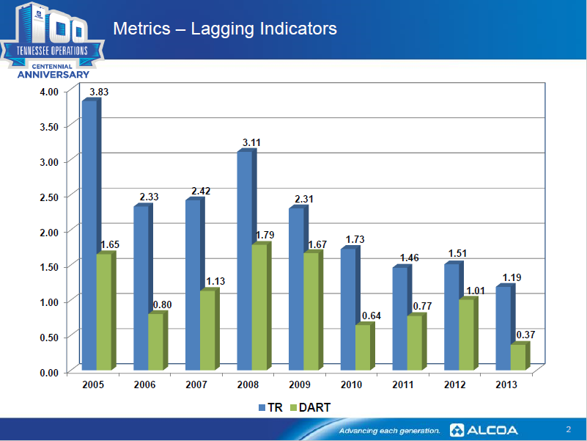
The Legacy – Safety & Financial Performance:
Alcoa Global Lost Workday Rate = 0.126 in 2014
Improved market cap 9X (1987 USD4Bn to 2007 USD28Bn)
  Market crash in Fall 2008, followed by restructuring, divestments
Tennessee Operations are typical.
Case 12: Lessons from the ALCOA Success Story
12
Notes:
12

Slide 13
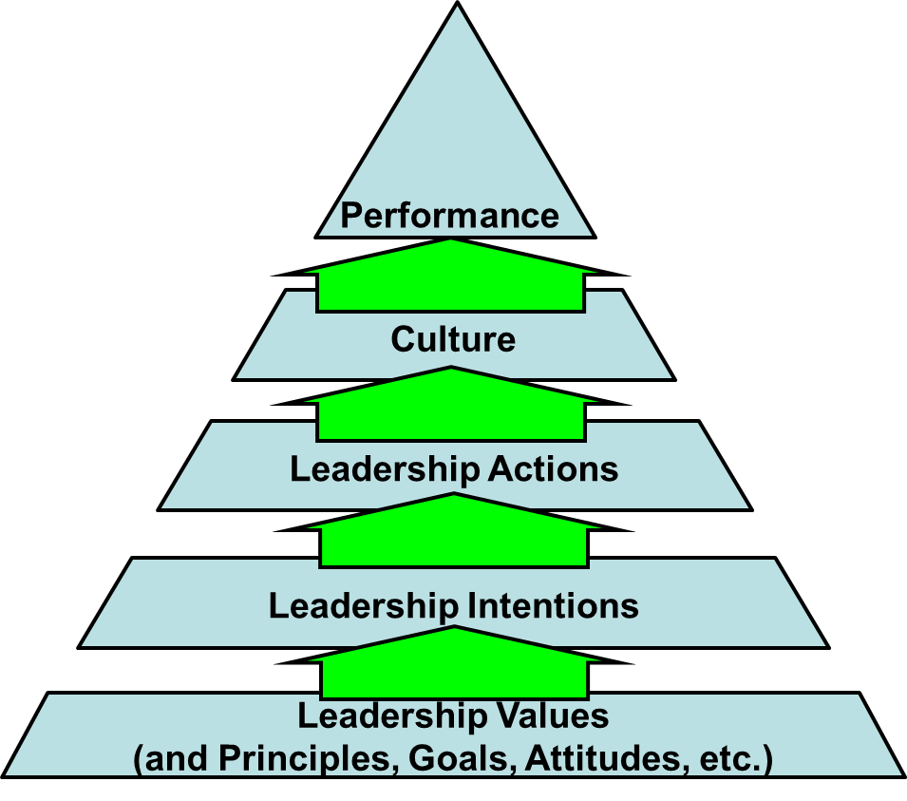
The Effective Leader Sets the Foundation for Performance:
Recall Chapter 7.7: Leadership – What Makes an Effective Leader?
The strategy that Paul O’Neill formulated and
executed was evident at all of these layers.
Measure what’s important …
and it gets managed.
Culture formed by line management
actions: “Don’t fail an audit.
Don’t mess with safety.”
Paul O’Neill’s actions were
consistent with his intentions.
“Here is what I mean by this
(zero injuries is our goal)
… I don’t want to budget it, I want to fix it.”
Case 12: Lessons from the ALCOA Success Story
13
Notes:
13

Slide 14
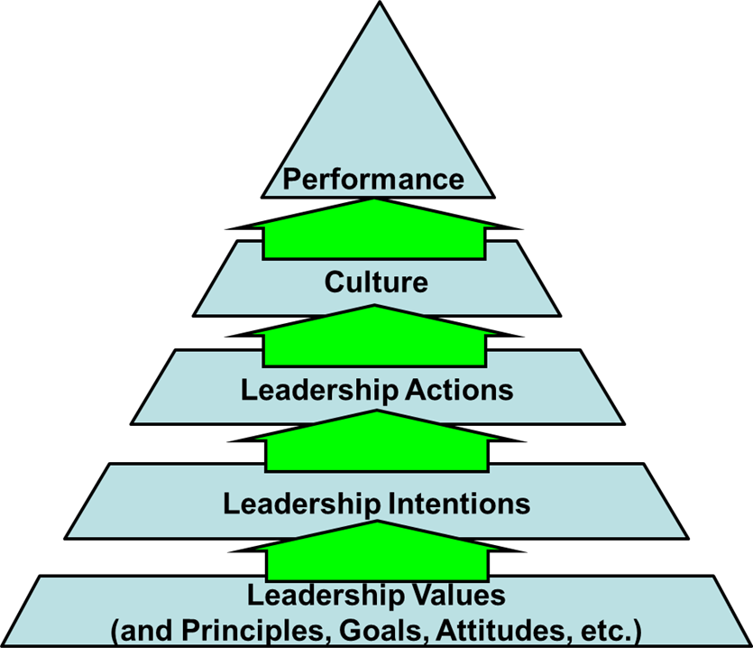
Summary and Key Lesson:
Summary:
Pearson’s Law: “When performance is measured, performance improves. When performance is measured and reported back, the rate of improvement accelerates.”
Change starts with the values set at the top of the organization.
“Zero Injuries” “Safety is a precondition (value).”
Five Practicable Programs:
  Safety at the Top of all Meeting Agendas:
  Report Incidents Within 24 Hours:
  Real-time Safety Performance Data:
  Safety Audit System and Department:
  Plant Manager Training:
Performance is founded on leadership values.
Key Lessons:
This case study and approach can be used to critique the culture and performance of any organization using the principles and practices of leadership in risk management.
Do everything possible to effectively implement the safety program at your plant. “ESG KP#2 Understand your program.”
Case 12: Lessons from the ALCOA Success Story
14
Notes:
14

Slide 15
Any questions?
Notes:
15

Slide 16
Reference only. Intent is NOT
to view the video in class.
Five Practicable Programs:
Excerpts from Video: Safety First at Alcoa with former Alcoa vice president Bill O'Rourke; Carnegie Council; 18-Sept-2012; 5:05 m:ss; accessed 31-Oct-2019; https://www.youtube.com/watch?v=dPAyBgWLm0A
53 Case12 ALCOA vid2 ONeill Safety First Carnegie Council 5m05s
00:23-01:20 Safety at the Top of the Meeting Agenda:
  Plant managers, Sr. Mgmnt, Board of Directors, Shareholders, Financial Analysts
01:33-02:30 Report Incidents Within 24 Hours:
  Who was hurt?
  Why they were hurt?
  What have you done about it?
02:30-03:27 Real-time Safety Performance Data:
03:27-04:15 Safety Audit Program and Department:
04:16-04:32 Plant Manager Training:
The training boiled down to two lessons for Plant Managers:
  Don’t fail an audit.
  Don’t mess with safety.
Case 12: Lessons from the ALCOA Success Story
16
Notes:
16
Video: Safety First at Alcoa with former Alcoa vice president Bill O'Rourke; speaking about the changes implemented by the former Alcoa CEO Paul O'Neill to the Carnegie Council for Ethics in International Affairs; 18-Sept-2012; https://www.youtube.com/watch?v=dPAyBgWLm0A; 5:05 m:ss; accessed 31-Oct-2019
“Former Alcoa vice president Bill O'Rourke details the many successful safety policies that former Alcoa CEO Paul O'Neill implemented at the giant aluminum manufacturer. O'Neill later became secretary of the treasury under President George W. Bush.”
00:23-01:20 Safety Was The First Point Of Discussion: annual shareholders’ meetings, Board of Directors meetings; every quarterly review with senior management; management meetings
01:33-02:30 Report Incidents Within 24 Hours: Questions directed to the plant manager / business manager: “Who was hurt, why they were hurt, and what have you done about it?”
02:30-03:27 Real-time Safety Performance Data: plant managers are accountable for safety performance, not the safety manager / safety professional
03:27-04:15 Safety Audit System and Department: with same level and discipline as a financial audit; plant managers reported audit failures directly to the Board of Directors

Slide 17
This slide is in the Student Version
Change Starts at the Top:
Recall that to improve performance, culture must change, and that to change culture, the change starts at the very top of the organization.
So, the change in values at the Top initiates the change in corporate culture.
Paul O'Neill CEO of Alcoa - It's all about safety; Charter Partners; posted 12-Jun-2015; 12m58s; accessed 31-Oct-2019 https://www.youtube.com/watch?v=tC2ucDs_XJY
53 Case12 ALCOA vid1 ONeill Its all about safety Charter Partners 12m58s.mp4
01:39- 02:13 “What is it am I going to do at Alcoa? .. What is it you want to be remembered for when you leave? … And at the top of my list was safety.”
02:15-05:20 The organization that has the potential for greatness: “It is possible for every person in the organization can say ‘yes’ to three questions without hesitation:”
  Are you treated with dignity and respect every day by every one you encounter?
  Are you given the things you need – tools, training, encouragement – so that you can make a contribution that gives meaning to your life?”
  Do you get recognized for what you do?
05:22-07:00 Humans are our most important asset: LTI=5 America, LTI=1.86 at Alcoa in 1987; “Our goal is going to be zero.” ONeill acknowledged that there will be hurdles and challenges, but remained committed to steadfastly overcome them..
05:22-07:00 Humans are our most important asset: LTI=5 America, LTI=1.86 at Alcoa in 1987; “Our goal is going to be zero.”
07:50-08:35 “Here is what I mean by this (zero injuries is our goal) … I don’t want to budget it (the means to address a safety concern), I want to fix it.”
08:36-09:31 “The things that move organizations are not happy stories.” The story of the 18-yo worker killed on the job.
09:32-10:59 “We killed him. I killed him.” Management accountability at its best under the 09:32-10:59 “We killed him. I killed him.” Management accountability at its best under the most unfavorable, difficult, and unpleasant of conditions.
10:59-12:09 “Safety is a precondition (value) for organizational behaviour.” “We are responsible. I am responsible.”
When leadership upholds these values, “dignity and respect”, and “nobody gets hurt around here”, it follows that this initiating culture creates a sense of ownership and a sense of pride in all that we do.
Case 12: Lessons from the ALCOA Success Story
17
Notes:
17

Slide 18
References to Supplemental Resources:
2018 Alcoa Sustainability Report; 12-April-2019; accessed 31-Oct-2019; https://www.alcoa.com/sustainability/en/default.asp
The Power of Safety Leadership: Paul O’Neill, Safety and Alcoa; Posted by Aerossurance, 29-Dec-2014; accessed 31-Oct-2019; http://aerossurance.com/helicopters/paul-oneill-safety-alcoa-power-safety-leadership/
Alcoa’s Key to Safety Success: Communication & Keystone Habit; Strategic Discipline Blog; posted by Douglas A Wick on 18-Sept-2014; accessed 31-Oct-2019; http://strategicdiscipline.positioningsystems.com/bid/104994/Alcoa-s-Key-to-Safety-Success-Communication-Keystone-Habit
How Changing One Habit Helped Quintuple Alcoa's Income; Business Insider; posted by Drake Baer 09-Apr-2014accessed 31-Oct-2019; https://www.businessinsider.com/how-changing-one-habit-quintupled-alcoas-income-2014-4
Pearson’s Law; Strategic Discipline Blog; Posted by Douglas A Wick on 11-Aug-2014; http://strategicdiscipline.positioningsystems.com/bid/104508/Pearson-s-Law
Alcoa Global EHS Policy 19Dec2016; accessed 31-Oct-2019; https://www.alcoa.com/sustainability/en/pdf/EHS-Values-Policy-Principles.pdf
Paul O'Neill CEO of Alcoa - It's all about safety; Charter Partners; posted 12-Jun-2015; https://www.youtube.com/watch?v=tC2ucDs_XJY
Paul O'Neill The Irreducible Components of Leadership; Paul O-’Neill, 22-March-2012; accessed 31-Oct-2019; https://www.youtube.com/watch?v=htLCVqaLBvo
Paul O'Neill CNN Interview Worker Safety at ALCOA; CNN News with Fareed Zakaria; 29-May-2014; accessed 31-Oct-2019; https://www.youtube.com/watch?v=56a3-Sc65M8
Profile of Paul O'Neill, Alcoa CEO on CNN Business; CNN Business News; 11-Sept-2012; accessed 31-Oct-2019; https://www.youtube.com/watch?v=yclcW9Tw_cs
Safety First at Alcoa with former Alcoa vice president Bill O'Rourke; speaking about the changes implemented by the former Alcoa CEO Paul O'Neill to the Carnegie Council for Ethics in International Affairs; 18-Sept-2012; 5:05 m:ss; accessed 31-Oct-2019; https://www.youtube.com/watch?v=dPAyBgWLm0A
The Hon Mr Justice Haddon-Cave – “Piper 25”; OilandGasUK; posted 20-June-2013; The Hon. Mr Justice Haddon-Cave addresses conference delegates at Piper 25, June 2013 on the topic entitled 'Leadership and Culture, Principles and Professionalism, Simplicity and Safety - Lessons from the Nimrod Review; accessed 31-Oct-2019; https://www.youtube.com/watch?v=y99_lhFFCsk
Google Financial Services “alcoa stock price history”; accessed 25Nov-2019; https://www.google.com/search?source=hp&ei=NYTcXcDaN_Ww0PEPjei02AY&q=alcoa+stock+price+history&oq=alcoa+stock+&gs_l=psy-ab.1.6.0l10.4703.9363..13920...3.0..0.314.1714.3j9j0j1......0....1..gws-wiz.....6..0i362i308i154i357j0i131j0i70i250.t6ROvaHHwZM
Case 12: Lessons from the ALCOA Success Story
18
Notes:
18

